Slide 1

Twitter sentiment analysis
Nlp project discussion
This Photo by Unknown Author is licensed under CC BY-SA-NC

Slide 2
Table of content
introduction
Motivation
Proposed system
Code snippets
Applications
Result & conclusion
references

Slide 3
introduction
Abstract
twitter the social network has a huge importance due to its significant uniqueness of not being a visually based social network that is prevalent today. Twitter has been known for its straight message transmissions from the sender to the receiver. On Twitter everyone can interact with everyone from celebrities and politicians to farmers and students
twitter is a witty and smart social network , users used to have 280 or less to compose their message twitter offers distinctive ways of communication that are mainly text based
twitter as been a source for event evacuations like tornado🌪
As of the second quarter of 2021, Twitter had 206 million monetizable daily active users worldwide

Slide 4
Cont.……
Sentiment analysis
sentiment analysis or opinion mining is the computational study of people’s opinion , sentiments , attitudes and emotions expressed in written language .
Is one of the most active research areas In natural language processing and text minning in recent years
Some popular sentiment analysis applications include social media monitoring , customer support management and analyzing customer feedback

Slide 5
Motivation
Problem statement
the problem we are tackling today is to analyze a twitter dataset that doesn’t have many similarities in between data frames , wo we had to get creative in our business model
The problem in sentiment analysis is classifying the polarity of a given text or document
Whether the expressed opinion in a document ,or sentence of an entity feature is positive , negative , or neutral
The presence of a large dataset is always recommended (for better traing of the classifier) and twitter makes it possible to obtain any number of tweets during a desired period by using a twitter developer account that connects you to an API with some extra features

Slide 6
Cont.…..
Objectives
To implement an algorithm for automatic classification of text into positive ,negative or neutral.
Sentiment analysis to determine the attitude of the mass is positive negative or neutral towards the subject of interest
Graphical representation of the sentiment in form of plot chart

Slide 7
Proposed system
input
Tweets dataset
Data pre-processing
Classified tweets
Sentiment graphical representation
Classification algorithm

Slide 8
Graphical representation of the sentiment

Slide 9
challenges
All tweets were converted to lower case
All links and urls were replaced by generic word
All usernames were replaced by generic word
Words with hashtags were replaced with the same words without the hashtags
Punctuations and additional white spaces were removed from the tweets
All the work was done by using python via regular expressions matching , nltk library

Slide 10
Steps
Gather twitter data
Prepare data
Preprocessing the data set
Splitting the data set
Create a twitter sentiment analysis model
Evaluate the model

Slide 11
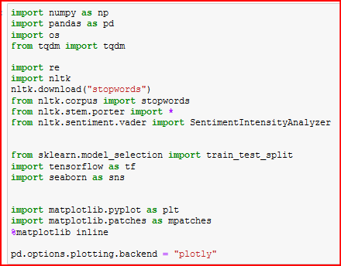
Snippets of code :
Different packages that were used during the creating of this model

Slide 12
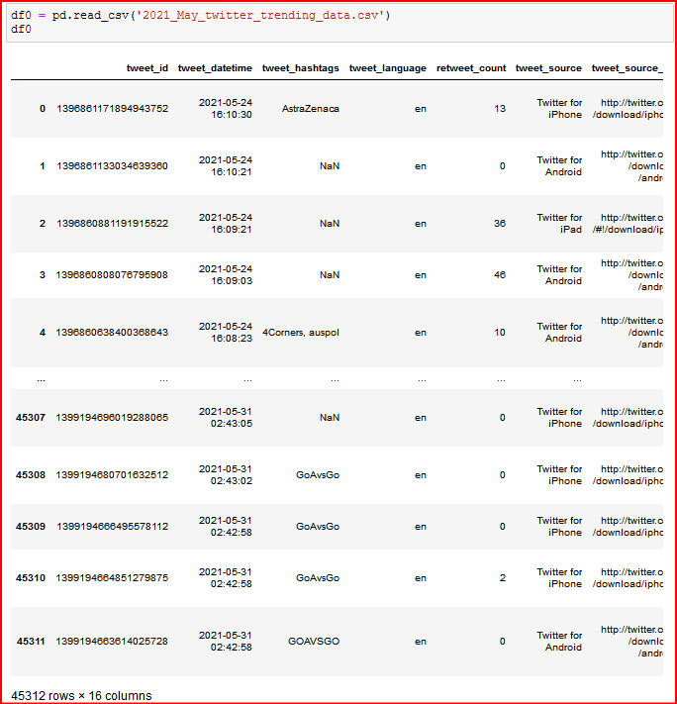
Snippets of code :
Creating a data frame of the data set so the original data set doesn’t get corrupted

Slide 13
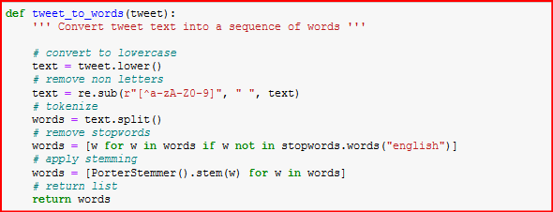
Snippets of code :
Converting tweets into sequence of words

Slide 14

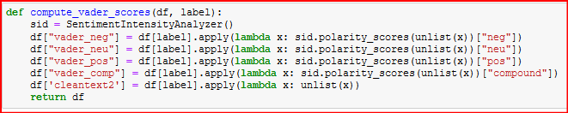
Snippets of code :
Creating a list of the processed clean text and parsing it to vader scores for computing the polarity of tokens

Slide 15
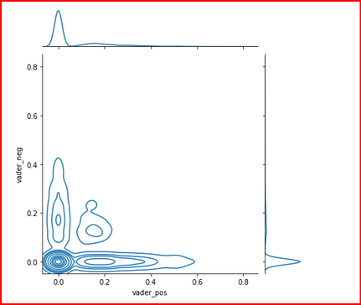
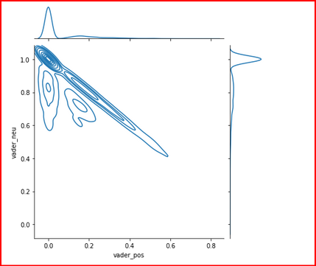
Snippets of code :
Plotting the positive and negative vader scores vs. the original data positive and negative scores

Slide 16
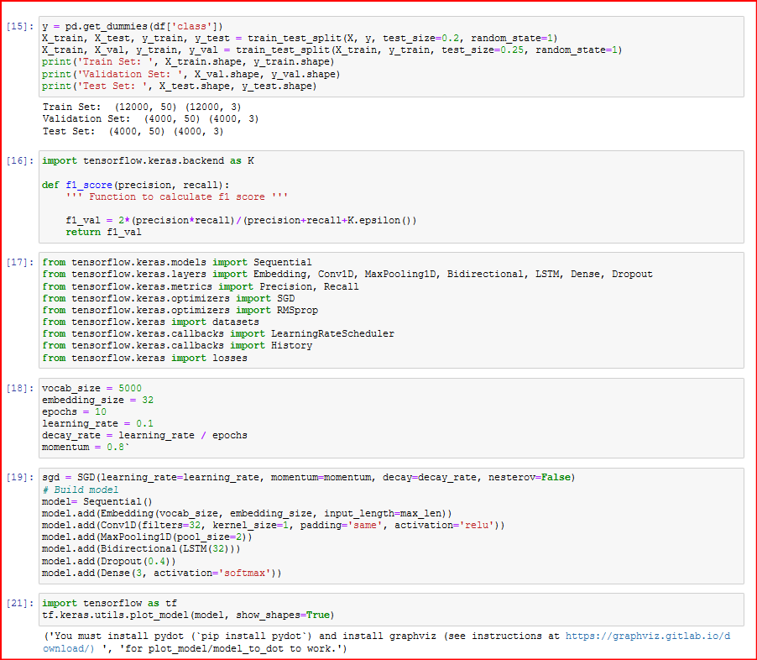
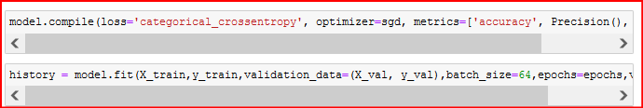
Snippets of code :
Creating and traing the model

Slide 17
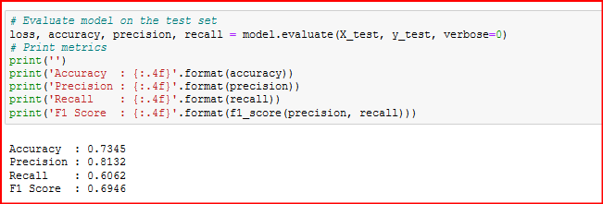
Snippets of code :
Evaluate the model

Slide 18
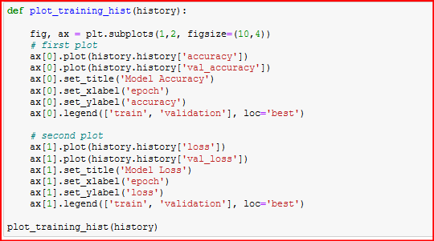
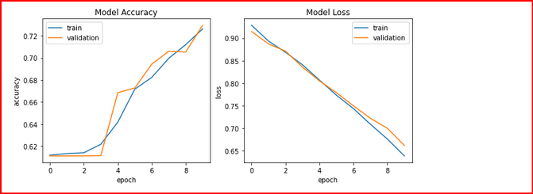
Snippets of code :
Model loss and accuracy

Slide 19
Applications of sentiment analysis
Customer service response
Outbreaks detections , like with the corona virus outbreak there were tons of info related to protection and the cause
Behavioral analysis and modification
Stock market movement identification
Helps with the advance of artificial systems to understand humans more

Slide 20
Your best quote that reflects your approach… “It’s one small step for man, one giant leap for mankind.”
- Neil Armstrong

